Slide 1


Outlier Detection
An Outlier is an observation in a given dataset that lies far from the rest of the observations.
For example, while measuring the body temperature of patients in a hospital there was an entry of 988 degrees Celsius which is clearly incorrect. There might be a missing decimal point like it should have been 98.8 instead of 988.
Another example is while measuring the weights of high school students, there was an entry with a weight of 1234 which is highly unlikely.
Notes:
A celebrity in the crowd of commoners is an outlier

Slide 2
Importance of dealing outliers
If the outliers are not treated in the first step while doing the exploratory data analysis, it can lead to biases in the results.
Notes:
Sometimes It’s difficult to decide whether to keep an outlier or not. (example: Scatter Plot of student’s marks and their IQR)

Slide 3
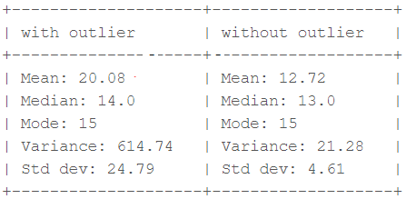
Example:
Consider a small dataset, sample= [15, 101, 18, 7, 13, 16, 11, 21, 5, 15, 10, 9].
By looking at it, one can quickly say ‘101’ is an outlier that is much larger than the other values.
Notes:
Frustration - common human tendency

Slide 4
Reason for an outlier exists in the dataset
data entry error.
Variability in the dataset.
The range of outliers depends on business problems and can change from case to case.
Every time outliers are not dangerous
Let’s say if we have age data, we get a person age 300, then it is absurd so we have to remove it.
Otherwise, Let’s say if we have to check the error in credit card transactions. Then we have to keep a record of outliers.
So keeping or not keeping outliers depends on the problem statement.
Notes:
Sometimes It’s difficult to decide whether to keep an outlier or not. (example: Scatter Plot of student’s marks and their IQR)

Slide 5
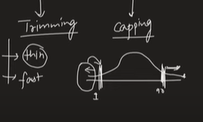
How to treat an outlier?
Trimming
Capping
Notes:
Frustration - common human tendency

Slide 6
Various ways of finding an outlier
Using z score
Using the Interquartile range
Using Percentile
Notes:
Frustration - common human tendency

Slide 7
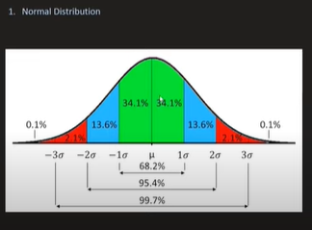
Notes:
Frustration - common human tendency

Slide 8
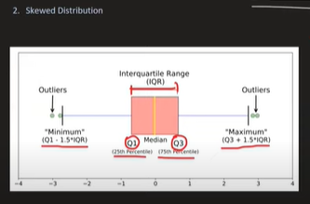
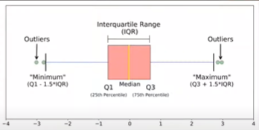
Notes:
Frustration - common human tendency

Slide 9
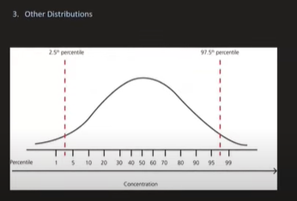
Notes:
Frustration - common human tendency

Slide 10

Thank you

